Slide 1
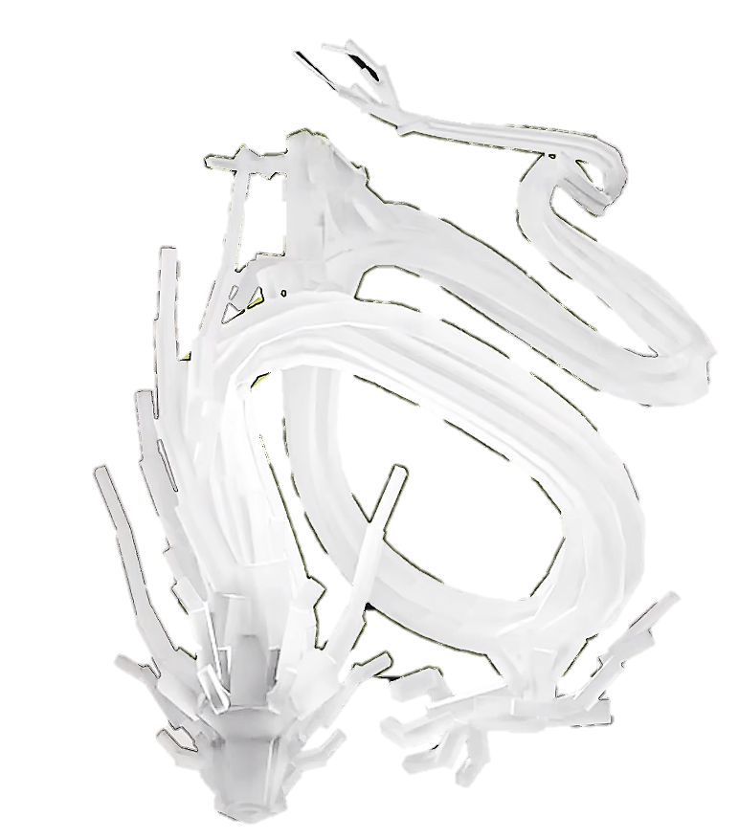


Traffic Flow Dynamic
Gong Ziyang

Slide 2

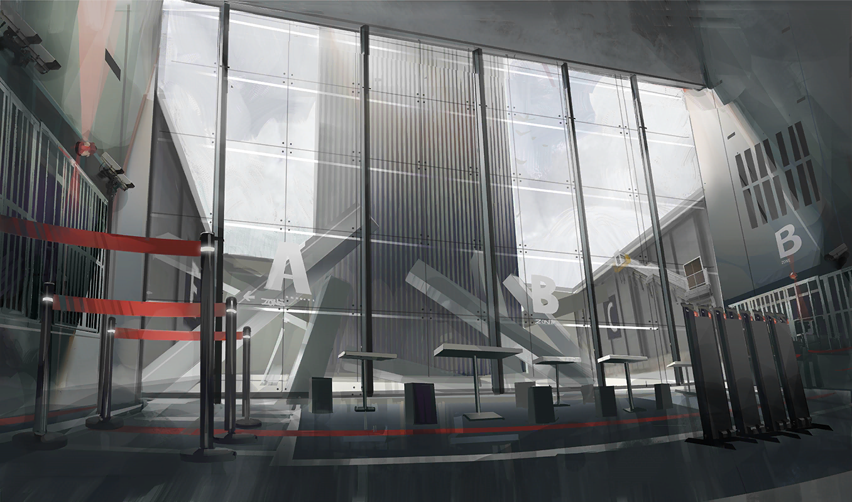
rhodeskesi
Chapt18.
建议使用：带图小标题
可以修改右侧文字 介绍
英文字体：Novecento wide
中文字体：思源黑体

Slide 3
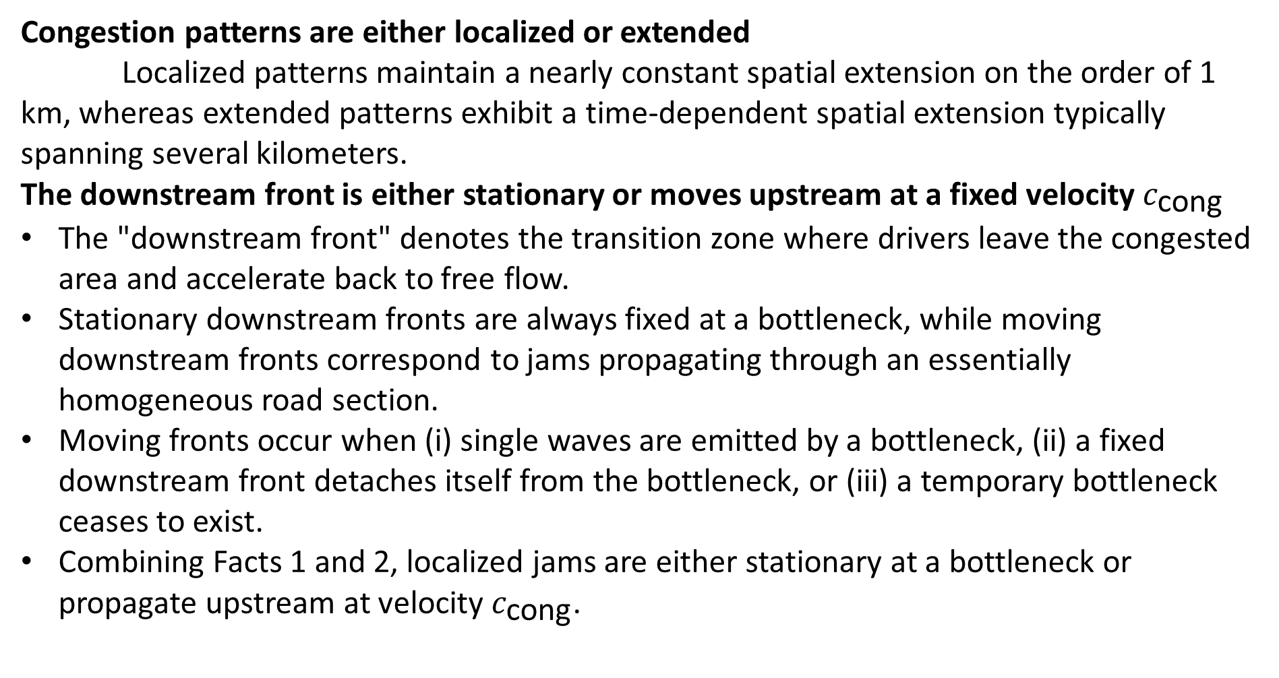
18.3 "stylized facts" of congested traffic
rhodeskesi
Congestion patterns are either localized or extended
Localized patterns maintain a nearly constant spatial extension on the order of 1 km, whereas extended patterns exhibit a time-dependent spatial extension typically spanning several kilometers.
The downstream front is either stationary or moves upstream at a fixed velocity $c_{\text{cong}}$
The "downstream front" denotes the transition zone where drivers leave the congested area and accelerate back to free flow.
Stationary downstream fronts are always fixed at a bottleneck, while moving downstream fronts correspond to jams propagating through an essentially homogeneous road section.
Moving fronts occur when (i) single waves are emitted by a bottleneck, (ii) a fixed downstream front detaches itself from the bottleneck, or (iii) a temporary bottleneck ceases to exist.
Combining Facts 1 and 2, localized jams are either stationary at a bottleneck or propagate upstream at velocity $c_{\text{cong}}$.

Slide 4
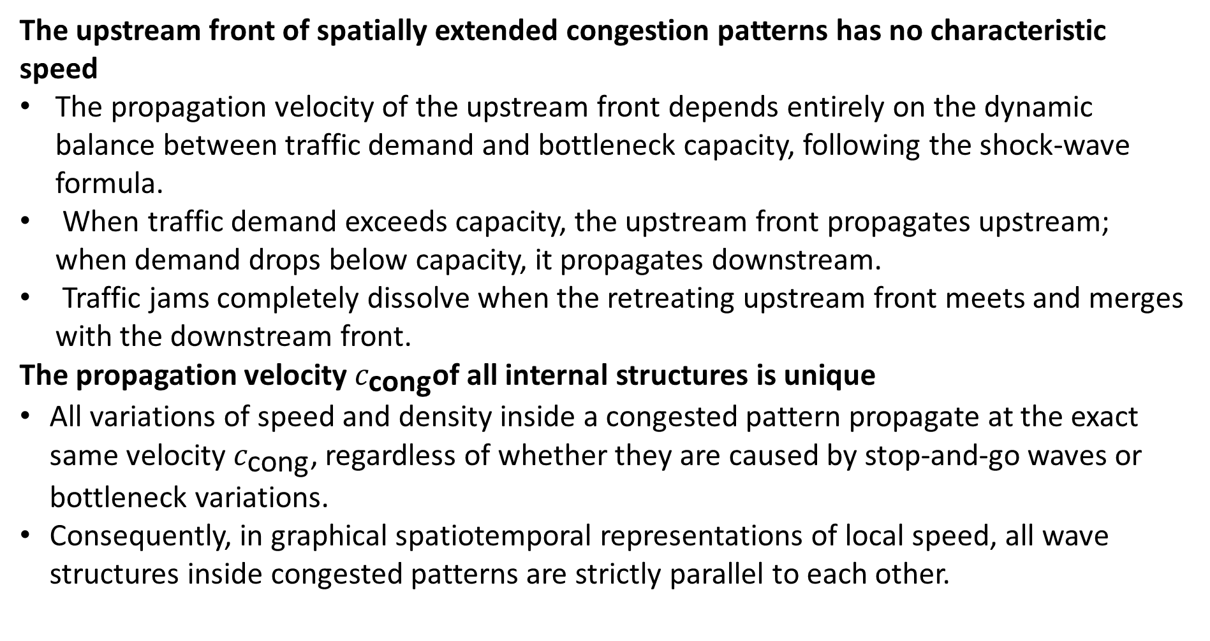
18.3 "stylized facts" of congested traffic
rhodeskesi
The upstream front of spatially extended congestion patterns has no characteristic speed
The propagation velocity of the upstream front depends entirely on the dynamic balance between traffic demand and bottleneck capacity, following the shock-wave formula.
When traffic demand exceeds capacity, the upstream front propagates upstream; when demand drops below capacity, it propagates downstream.
Traffic jams completely dissolve when the retreating upstream front meets and merges with the downstream front.
The propagation velocity $c_{\text{cong}}$of all internal structures is unique
All variations of speed and density inside a congested pattern propagate at the exact same velocity $c_{\text{cong}}$, regardless of whether they are caused by stop-and-go waves or bottleneck variations.
Consequently, in graphical spatiotemporal representations of local speed, all wave structures inside congested patterns are strictly parallel to each other.

Slide 5
18.3 "stylized facts" of congested traffic
rhodeskesi
The frequency of traffic waves increases with the bottleneck strength
Typical periods of internal quasi-periodic oscillations vary between 4 min and 60 min, corresponding to wavelengths between 1 km and 15 km.
The stronger the bottleneck producing the congestion (such as a lane-blocking accident compared to a mild uphill gradient), the higher the frequency of the resulting stop-and-go waves.
Due to the unique propagation velocity in Fact 4, temporal frequency and wavelength are directly coupled: increasing frequencies correspond to decreasing wavelengths.
The amplitude of traffic waves increases during propagation
Traffic waves grow in amplitude (sometimes to full saturation) as they propagate upstream.
This empirical fact provides strong evidence that traffic flow inside extended congested patterns is convectively unstable.

Slide 6
18.3 "stylized facts" of congested traffic
rhodeskesi
Light or very strong bottlenecks may cause homogeneous extended traffic patterns
Light bottlenecks or extremely severe bottlenecks can generate homogeneous extended traffic patterns without pronounced wave oscillations.
For strong bottlenecks, this empirical evidence remains debated, because at high congested densities the oscillation periods reach the detector aggregation interval and smoothing window, making oscillations hardly distinguishable from noise.

Slide 7
18.3 Role That These Stylized Facts Play
rhodeskesi
Serve as the standard for validating microscopic car-following and macroscopic models; any model failing to reproduce these seven facts is physically flawed.
Provide quantitative criteria for engineers to diagnose bottleneck types, estimate queue dissipation, and design targeted control strategies.

Slide 8
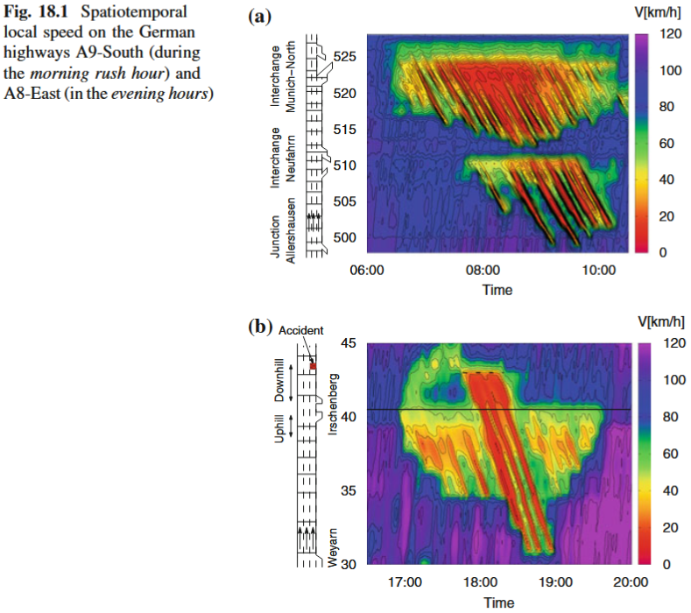
18.4 Empirical Reality: Complex Patterns
Congested traffic flow patterns are rarely isolated from each other.In most cases, they interact with each other resulting in complex traffic patterns
rhodeskesi
Moving jams may propagate through other congestions essentially unaffected
The jam caused by an accident at road 43.5 km on the Autobahn A8-East (Fig. 18.1a) propagates through the congested zone previously induced by the hilly region ("Irschenberg") near road 40 km.
However, it is also possible that a moving traffic wave gets "caught" by a deactivated or activated bottleneck.In the first case, the bottleneck generally becomes activated.

Slide 9
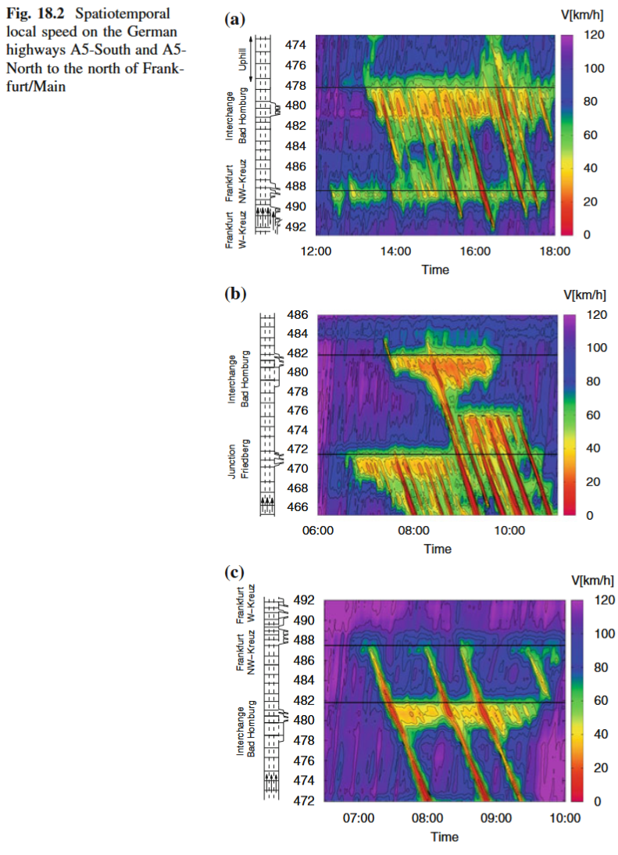
18.4 Empirical Reality: Complex Patterns
rhodeskesi
Moving jams may activate permanent bottlenecks.
In Fig. 18.2a–c, single MLC or TSG waves interact with deactivated and activated bottlenecks further upstream.
The single MLC originating from the interchange at road 488 km crosses a deactivated bottleneck at 482 km and activates it to produce a PLC pattern (Fig. 18.2c). The moving jam itself propagates essentially unaffected.

Slide 10
18.4 Empirical Reality: Complex Patterns
rhodeskesi
Congested traffic may cause new temporary bottlenecks
This is part of the complex situation on the German Autobahn A5 depicted in Fig. 18.2b.
An isolated traffic wave detaches from a PLC state at the interchange "Bad Homburg" at about 8:30 h and causes a temporary bottleneck at road 476 km.
The new bottleneck generates an extended OCT state. Later on, both the original MLC and the OCT of the temporary bottleneck intersect with an already activated bottleneck and its OCT pattern further upstream.

Slide 11
18.4 Empirical Reality: Complex Patterns
rhodeskesi
Bottleneck activation may alleviate the situation further downstream.
The capacity drop due to the temporary bottleneck at road 476 km reduces the flow downstream.The original PLC at road 482 km dissolves.

Slide 12
18.5 Fundamentals of Traffic State Estimation
rhodeskesi
Systems like dynamic routing, in-car navigation, and automated jam warnings require real-time estimation of the current network state and accurate 30-minute short-term forecasts of congestion evolution and travel times.
Stationary detectors in real-world networks are sparse, leaving massive data gaps; simultaneously, complex interacting traffic patterns cannot be solved purely through simple analytical formulas in an automated manner.

Slide 13
18.5 Fundamentals of Traffic State Estimation
Adopting Robust First-Order Macroscopic Models (CTM) for Super-Real-Time Rolling Simulation
First-order models with a triangular fundamental diagram (such as the Cell-Transmission Model, CTM, or section-based models) are selected because they are robust and computationally fast.
The system utilizes a rolling horizon (e.g., refreshing inputs every 5 minutes for a 30-minute prediction window), executing simulations at multiple times real-time speed.
rhodeskesi

Slide 14
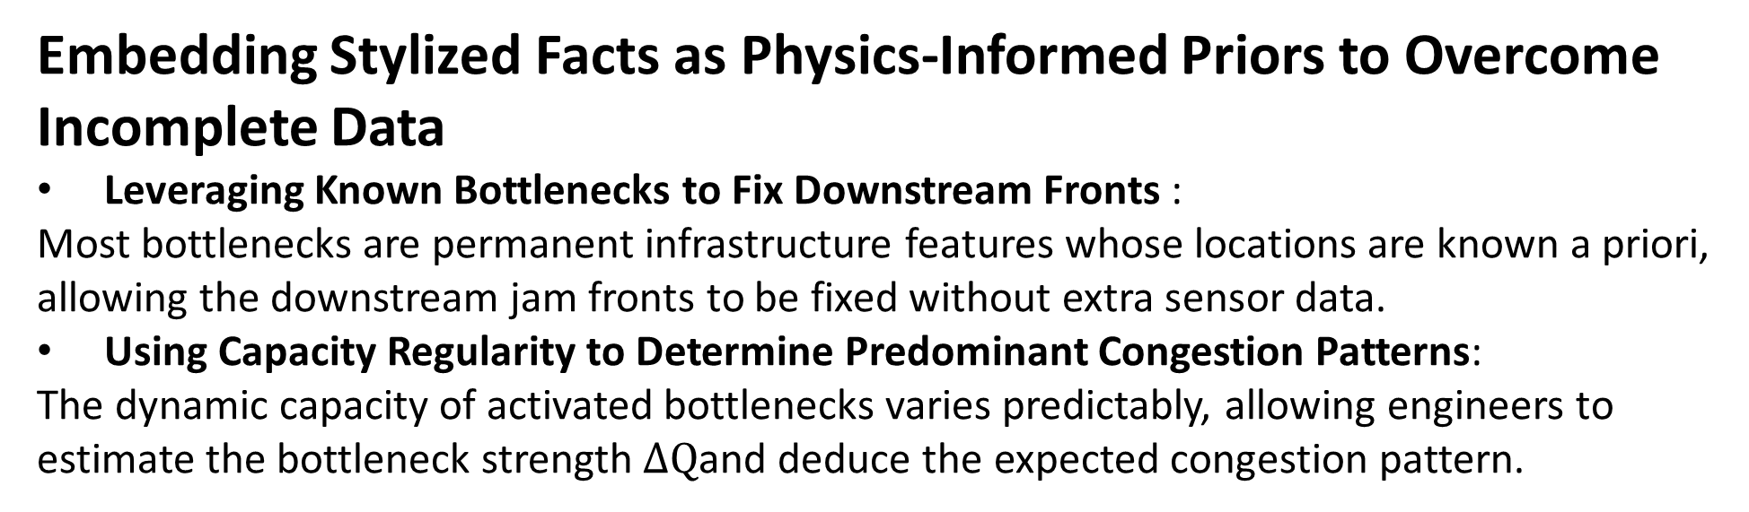
18.5 Fundamentals of Traffic State Estimation
Embedding Stylized Facts as Physics-Informed Priors to Overcome Incomplete Data
Leveraging Known Bottlenecks to Fix Downstream Fronts :
Most bottlenecks are permanent infrastructure features whose locations are known a priori, allowing the downstream jam fronts to be fixed without extra sensor data.
Using Capacity Regularity to Determine Predominant Congestion Patterns:
The dynamic capacity of activated bottlenecks varies predictably, allowing engineers to estimate the bottleneck strength $ΔQ$and deduce the expected congestion pattern.
rhodeskesi

Slide 15
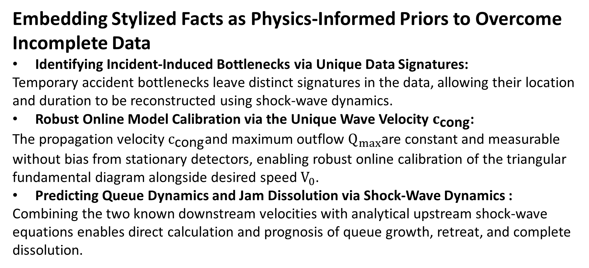
18.5 Fundamentals of Traffic State Estimation
Embedding Stylized Facts as Physics-Informed Priors to Overcome Incomplete Data
Identifying Incident-Induced Bottlenecks via Unique Data Signatures:
Temporary accident bottlenecks leave distinct signatures in the data, allowing their location and duration to be reconstructed using shock-wave dynamics.
Robust Online Model Calibration via the Unique Wave Velocity $c_{\text{cong}}$:
The propagation velocity $c_{\text{cong}}$and maximum outflow $Q_{max}$are constant and measurable without bias from stationary detectors, enabling robust online calibration of the triangular fundamental diagram alongside desired speed $V_{0}$.
Predicting Queue Dynamics and Jam Dissolution via Shock-Wave Dynamics :
Combining the two known downstream velocities with analytical upstream shock-wave equations enables direct calculation and prognosis of queue growth, retreat, and complete dissolution.
rhodeskesi

